Slide 1
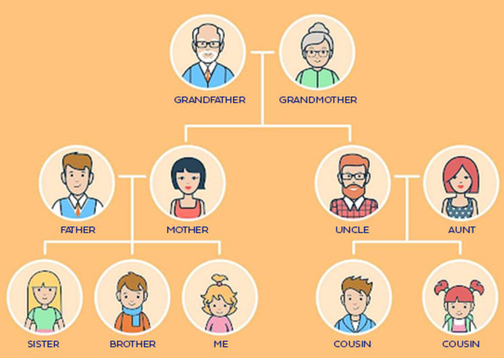
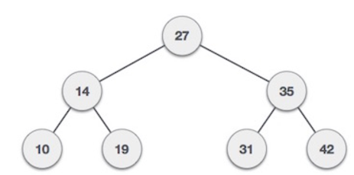
4. Trees
Part 1

Slide 2
Objectives
2
What is a Trees?
Tree Terminology
Tree examples
Ordered Trees
Tree Traversals
Binary Trees
Implementing Binary Trees
Binary Search Tree
Insertion
Deletion
Notes:
2

Slide 3
What is a Tree?
Trees, Binary Trees, and Binary Search Trees
In computer science, a tree is an abstract model of a hierarchical structure
A tree consists of nodes with a parent-child relation
Inspiration: family trees
Applications:
Organization charts
File systems
Programming environments
Every node except one (a root) has a unique parent.
Computers”R”Us
Sales
Manufacturing
R&D
US
International
Laptops
Desktops
Europe
Asia
Canada
Empty structure is an empty tree.
Non-empty tree consists of a root and its children, where these children are also trees.
Exact definition

Slide 4
Tree Terminology - 1
Root: unique node without a parent
Internal node: node with at least one child (A, B, C, F)
External (leaf) node: node without children (E, I, J, K, G, H, D)
Ancestors of a node: parent, grandparent, great-grandparent, …
Descendants of a node: child, grandchild, great-grandchild, etc.
Level of a node: The level of the root is 1. If a father has level i then its children has level i+1.
A
sub-tree
B
C
D
E
F
G
H
I
J
K
Sub-tree: tree consisting of a node and its descendants
(The level is known with other name: depth. In some documents a level of the root is defined as 0)
Height of a tree: maximum level in a tree, thus a single node is a tree of height 1. The height of an empty tree is 0.
Height of a node p is the height of the sub-tree with root p.
We can see that the height of a tree is the maximum number of nodes on a path from the root to a leaf node.
In text book and some other documents the height of a tree with single node is defined as 0

Slide 5
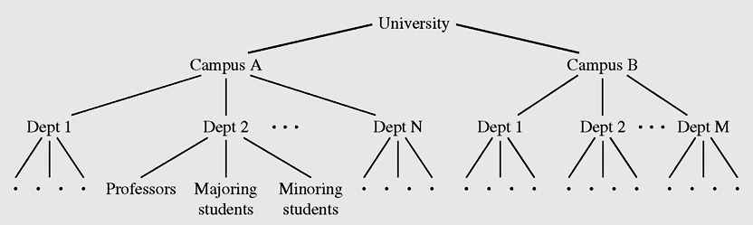
Tree Terminology - 2
Degree (order) of a node: number of its non-empty childrens.
Each node has to be reachable from the root through a unique sequence of arcs (edges), called a path
The number of arcs in a path is called the length of the path
Tree example: Hierarchical structure of a university shown as a tree
Data Structures and Algorithms in Java

Slide 6
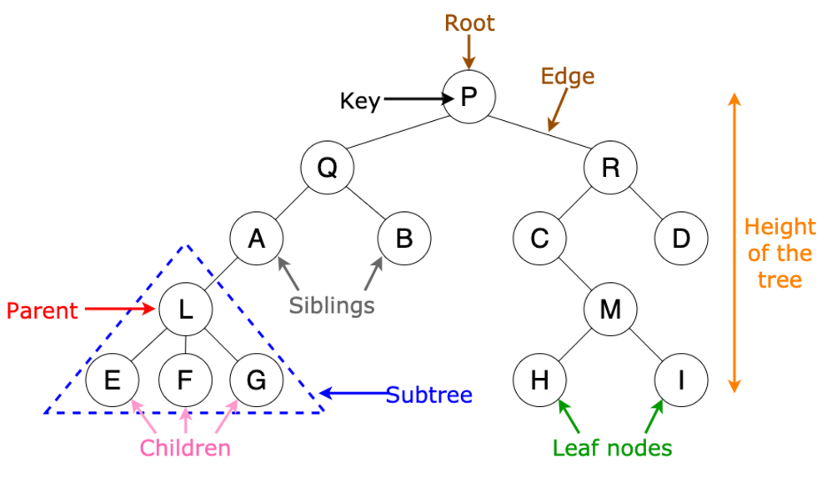
Tree examples
Ancestors
Descendants

Slide 7
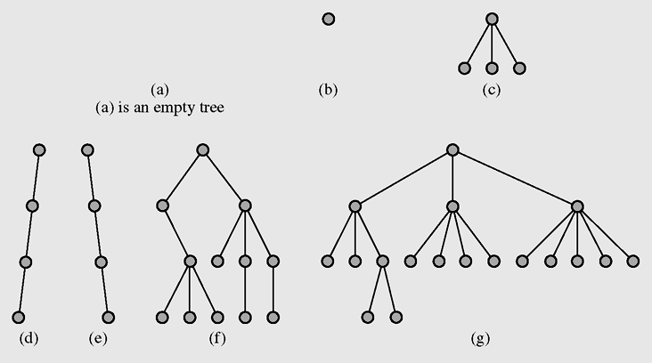
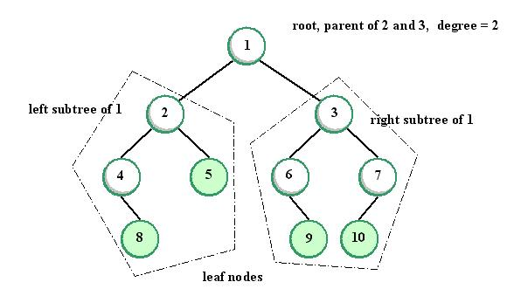
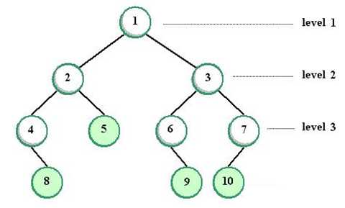
Tree examples
Image Source: JEDI
Notes:
Image Source: JED
Some books say: level of root = 0
7

Slide 8
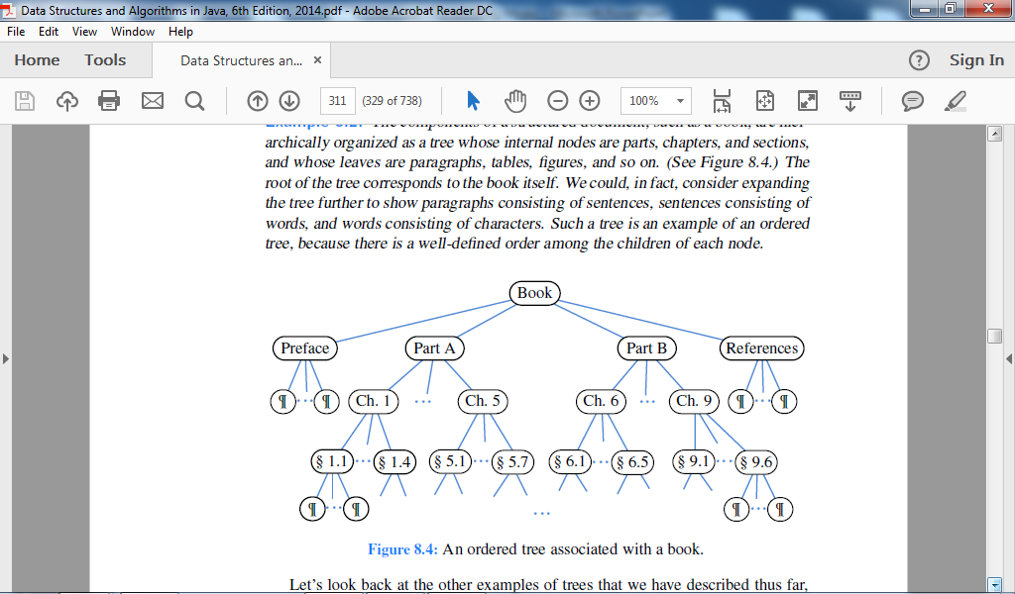
Ordered Trees
A tree is ordered if there is a meaningful linear order among the children of each node, that is, we purposefully identify the children of a node as being the first, second, third, and so on.
Such an order is usually visualized by arranging siblings left to right, according to their order.
Tree traversal is the process of visiting each node in the tree exactly one time.
An ordered tree associated with a book.

Slide 9
Breadth-first Traversal of a tree
In a breadth-first traversal, a node is visited first, then all its' children, then all its grandchildren,...
Application: visit family tree by generations.
Algorithm breadthFirst(v)
visit(v)
visit all childs v1,v2,.. of v
visit all childs of v1, then all childs of v2,..
1
Make Money Fast!
2
3
4
1. Motivations
2. Methods
References
5
6
7
8
9
1.1 Greed
1.2 Avidity
2.1 Stock Fraud
2.2 Ponzi Scheme
2.3 Bank Robbery
Data Structures and Algorithms in Java

Slide 10
Depth-first Traversal of a tree
In a depth first traversal, starts at the root node and examines each branch as far as possible before backtracking
Application: permutation tree, maze finder…
Algorithm depthFirst(v)
visit(v)
for each child w of v
depthFirst(v)
1
Make Money Fast!
2
5
9
1. Motivations
2. Methods
References
3
4
6
7
8
1.1 Greed
1.2 Avidity
2.1 Stock Fraud
2.2 Ponzi Scheme
2.3 Bank Robbery
Data Structures and Algorithms in Java

Slide 11
Pre-order Traversal of a tree
Pre/In/Post-order Traversals of General Tree
In a pre-order traversal, a node is visited before its descendants
Application: print a structured document
Algorithm preOrder(v)
visit(v)
for each child w of v
preOrder (w)
1
Make Money Fast!
2
5
9
1. Motivations
2. Methods
References
3
4
6
7
8
1.1 Greed
1.2 Avidity
2.1 Stock Fraud
2.2 Ponzi Scheme
2.3 Bank Robbery
Data Structures and Algorithms in Java

Slide 12
In-order Traversal of a tree
Pre/In/Post-order Traversals of General Tree
In a in-order traversal, the first child of node is traversed, then visit node, finally all other children of node are traversed
Application: print a structured document
Algorithm inOrder(v)
With u is the first child of v: inOrder (u)
visit(v)
for each child w of v
inOrder (w)
4
Make Money Fast!
2
6
9
1. Motivations
2. Methods
References
1
3
5
7
8
1.1 Greed
1.2 Avidity
2.1 Stock Fraud
2.2 Ponzi Scheme
2.3 Bank Robbery
Data Structures and Algorithms in Java

Slide 13
Post-order Traversal of a tree
In a post-order traversal, a node is visited after its descendants
Application: compute space used by files in a directory and its subdirectories
Algorithm postOrder(v)
for each child w of v
postOrder (w)
visit(v)
9
cs16/
8
3
7
programs/
todo.txt 1K
homework/
1
2
4
5
6
h1c.doc 3K
h1nc.doc 2K
DDR.java 10K
Stocks.java 25K
Robot.java 20K
Data Structures and Algorithms in Java

Slide 14
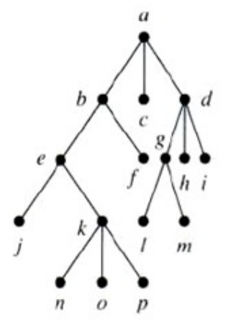
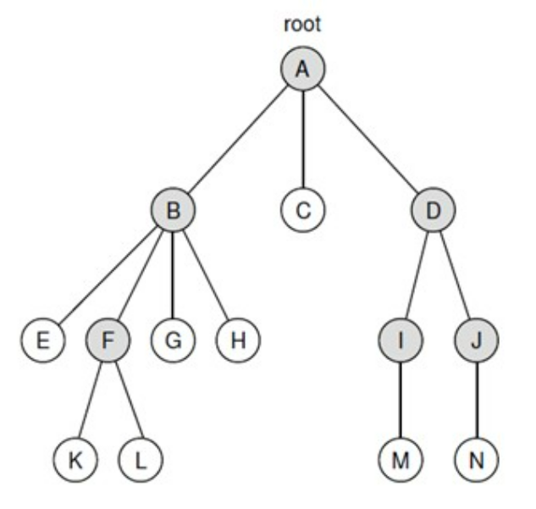
Ex. Traversals of General Tree
1. Depth-first, Breadth-first
2. Pre/In/Post-order
b)
a)

Slide 15
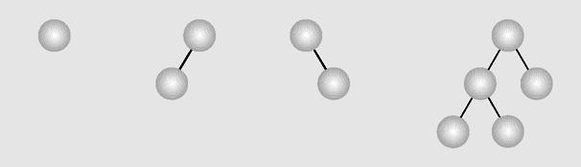
Binary Trees
A binary tree is a tree in which each node has at most two children. (Thus an empty tree is an binary tree). Each child may be empty and designated as either a left child or a right child
Examples of binary trees

Slide 16
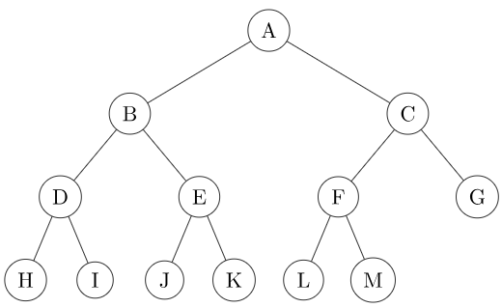
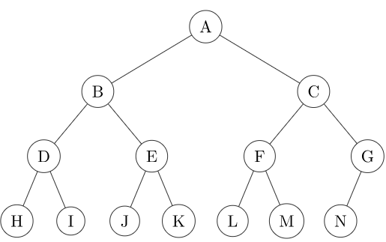
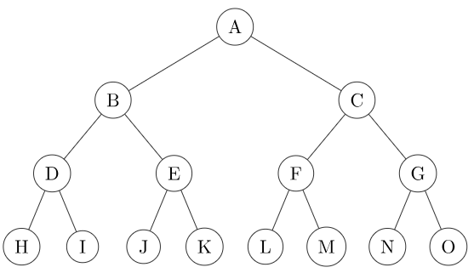
Types of Binary Trees
Proper Binary Tree (sometimes full binary tree or 2-tree): Every node has either 0 or 2 child nodes, i.e., left and right or no children.
Complete Binary Tree: All levels, except possibly the last, are filled, and all nodes are as left as possible
Perfect Binary Tree: All nodes have exactly two children, and all leaf nodes are at the same level
Notes:
Image source: JEDI (https://jedi.dev.java.net/)
16

Slide 17
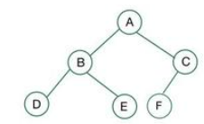
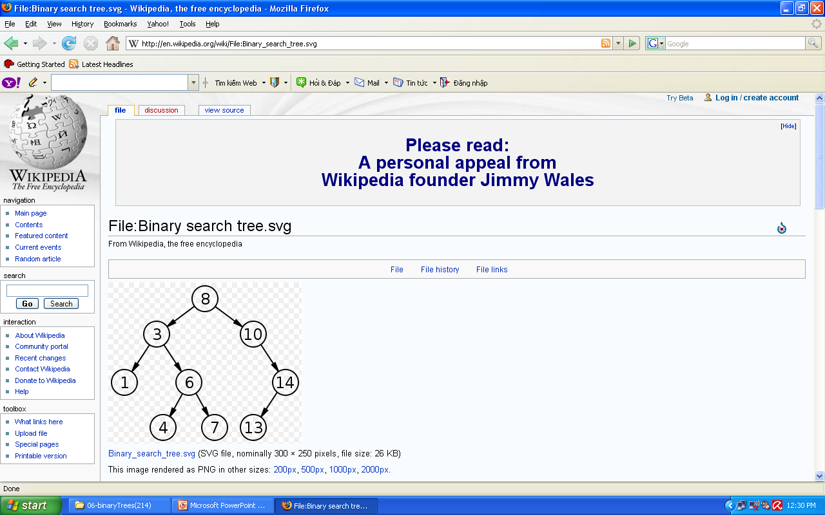
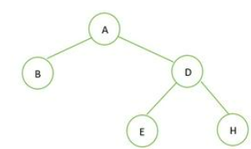
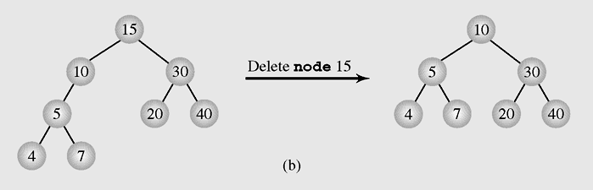
Proper / Full
Complete
Perfect

Slide 18
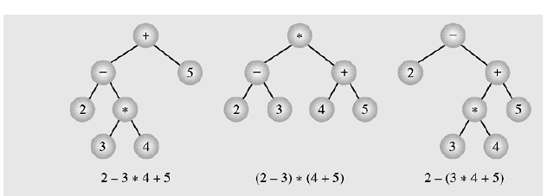
Binary Tree example – Expression Tree
Typical arithmetic expression tree is a proper binary tree, since each operator +, −, ∗, and / takes exactly two operands. Of course, if we were to allow unary operators, like negation (−), as in “−x,” then we could have an improper binary tree.
Notes:
Image Source: JED
Some books say: level of root = 0
18

Slide 19
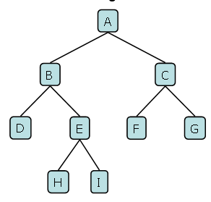
Binary Tree Traversals
Breadth-first traversal is visiting each node starting from the lowest (or highest) level and moving down (or up) level by level, visiting nodes on each level from left to right (or from right to left)
Depth-first traversal starts at the root node and examines each branch as far as possible before backtracking

Slide 20
Binary Tree Traversals
Breadth-first traversal (Level-order traversal) is visiting each node starting from the lowest (or highest) level and moving down (or up) level by level, visiting nodes on each level from left to right (or from right to left)
Depth-first traversal starts at the root node and examines each branch as far as possible before backtracking
Breadth-first traversal:
A, B, C, D, E, F, G, H, I
Depth-first traversal:
A, B, D, E, H, I, C, F, G

Slide 21
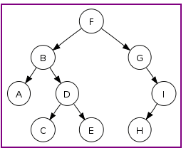
Pre/In/Post-order Traversals
Pre-order (NLR)
Algorithm preOrder(v)
visit(v)
preOrder (left child of v)
preOrder (right child of v)
21
N = node,
L = left,
R = right
In-order (LNR)
Algorithm inOrder(v)
inOrder (left child of v)
visit(v)
inOrder (right child of v)
Post-order (LRN)
Algorithm postOrder(v)
postOrder (left child of v)
postOrder (right child of v)
visit(v)

Slide 22
Pre/In/Post-order Traversals
22
Preorder traversal: F, B, A, D, C, E, G, I, H
Inorder traversal: A, B, C, D, E, F, G, H, I
Postorder traversal: A, C, E, D, B, H, I, G, F

Slide 23
Construct Binary Tree from given traversals
23
From given traversals we can construct the tree. More exactly speaking, we can construct a tree from inorder & preorder or inorder & postorder traversals.
Exp:
Inorder sequence: D B E A F C Preorder sequence: A B D E C F

Slide 24

Construct Binary Tree from given traversals
24
From given traversals we can construct the tree. More exactly speaking, we can construct a tree from inorder & preorder or inorder & postorder traversals.
Exp:
Inorder sequence: D B E A F C Preorder sequence: A B D E C F
In a Preorder sequence, leftmost element is the root of the tree. So we know ‘A’ is root for given sequences.
By searching root ‘A’ in Inorder sequence, we can find out all elements on left side of ‘A’ are in left subtree and elements on right are in right subtree.
We recursively follow above steps and get the following tree:

Slide 25
Implementing Binary Trees - 1
Binary trees can be implemented in at least two ways:
As arrays
As linked structures
As an array:
A node is declared as an object with an information field and two “reference” fields. These reference fields contain the indexes of the array cells in which the left and right children are stored, if there are any.
However, it is hard to predict how many nodes will be created during a program execution. (Therefore, how many spaces should be reserved for the array?)

Slide 26
Implementing Binary Trees - 2
26
To implement a tree as a linked structure, a node is declared as an object with an information field and two “reference” fields.
class Node
{
int info;
Node left, right;
Node(int x) { }
Node(int x, Node p, Node q)
{
info=x;
left=p;
right=q;
}
Node(int x)
{
this(x, null, null);
}
}
Key (data)
left child right child
class Node
{
int info;
Node left, right;
Node(int x)
{
info=x;
left=right=null;
}
}
Different types of implementations

Slide 27
Breadth-First Traversal code
void breadth()
{ if(root==null) return;
MyQueue q = new MyQueue();
q.enqueue(root);
Node p;
while(!q.isEmpty())
{
p = (Node) q.dequeue();
if(p.left !=null)
q.enqueue(p.left);
if(p.right !=null)
q.enqueue(p.right);
visit(p);
}
}
27
Top-down,
left-to-right

Slide 28
Depth-First Traversal code
28
void preOrder(Node p)
{
if(p==null) return;
visit(p);
preOrder(p.left);
preOrder(p.right);
}
void inOrder(Node p)
{
if(p==null) return;
inOrder(p.left);
visit(p);
inOrder(p.right);
}
void postOrder(Node p)
{
if(p==null) return;
postOrder(p.left);
postOrder(p.right);
visit(p);
}

Slide 29
Binary Search Trees
In computer science, a binary search tree (BST) is a node based binary tree data structure which has the following properties:
The left subtree of a node contains only nodes with keys less than the node's key.
The right subtree of a node contains only nodes with keys greater than the node's key.
Both the left and right subtrees must also be binary search trees.
From the above properties it naturally follows that:
Each node (item in the tree) has a distinct key.
An inorder traversal of a binary search trees visits the keys in increasing order

Slide 30
Implementing Binary Search Trees
30
class BSTree
{Node root;
BSTree() {root=null;}
void insert(int x) {... }
void visit(Node p) {...}
void preOrder(Node p) {...}
void inOrder(Node p) {...}
void postOrder(Node p) {...}
Node search(int x) {...}
void deleteByMerging(int x) {...}
void deleteByCopying(int x) {...}
}
class Node
{int info;
Node left, right;
Node(int x)
{info=x; left=right=null;
}
}

Slide 31
Searching on Binary Search Trees
31
Node search(Node p, int x)
{ if(p==null) return(null);
if(p.info==x) return(p);
if(x<p.info)
return(search(p.left,x));
else
return(search(p.right,x));
}

Slide 32
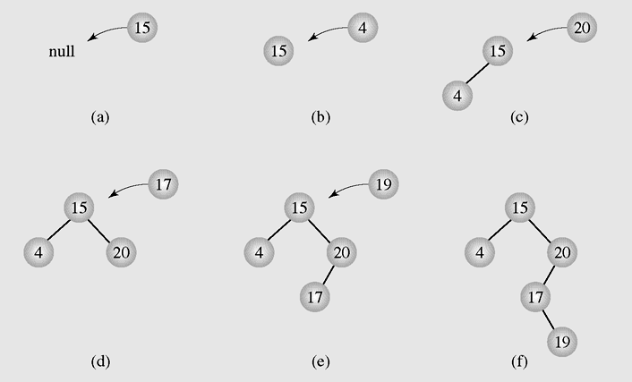
Insertion - 1
32
Inserting nodes into binary search trees

Slide 33
Insertion - 2
33
void insert(int x)
{if(root==null)
{root = new Node(x);
return;
}
Node f,p;
p=root;f=null;
while(p!=null)
{if(p.info==x)
{System.out.println(" The key " + x + " already exists, no insertion");
return;
}
f=p;
if(x<p.info)
p=p.left;
else
p=p.right;
}
if(x<f.info)
f.left=new Node(x);
else
f.right=new Node(x);
}

Slide 34
Deletion - 1
34
There are three cases of deleting a node from the binary search tree:
The node is a leaf; it has no children
The node has one child
The node has two children

Slide 35
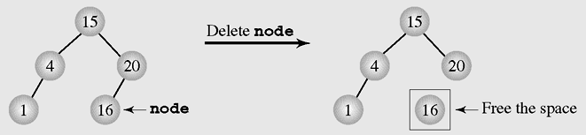
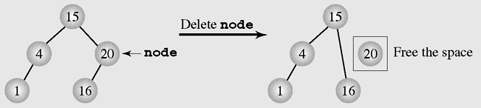
Deletion - 2
35
Deleting a leaf
Deleting a node with one child

Slide 36
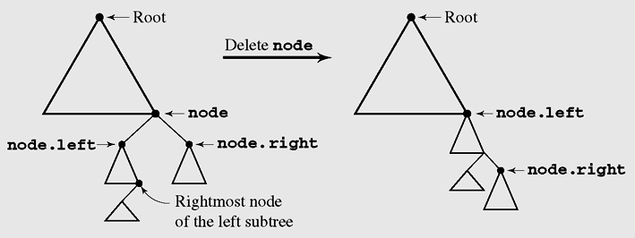
Deletion by Merging - 1
36
Making one tree out of the two subtrees of the node and then attaching it to the node’s parent is called deleting by merging
Deleting by merging

Slide 37
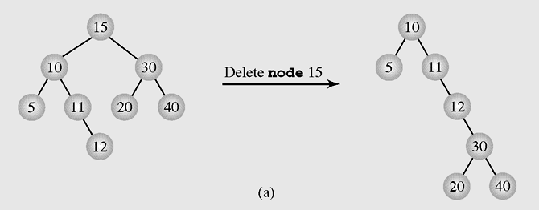
Deletion by Merging - 2
37

Slide 38
Deletion by Merging - 3
38
The height of a tree can be (a) extended or (b) reduced after deleting by merging

Slide 39
Deletion by Copying - 1
39
If the node has two children, the problem can be reduced to:
The node is a leaf
The node has only one non-empty child
Solution: replace the key being deleted with its immediate predecessor (or successor)
A key’s predecessor is the key in the rightmost node in the left subtree

Slide 40
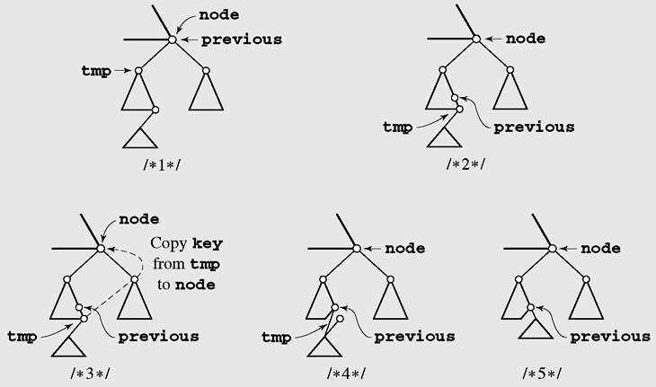
Deletion by Copying - 2
40

Slide 41
Deletion by Copying - 2
41

Slide 42
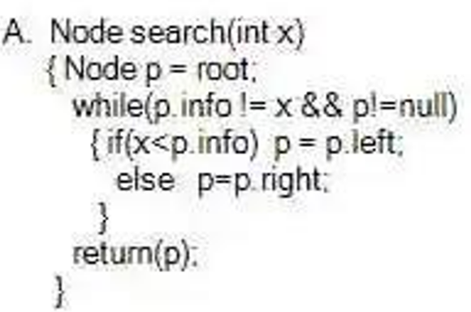
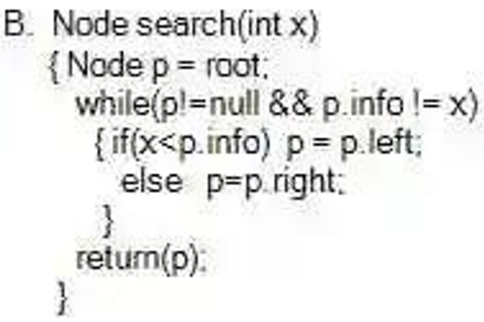
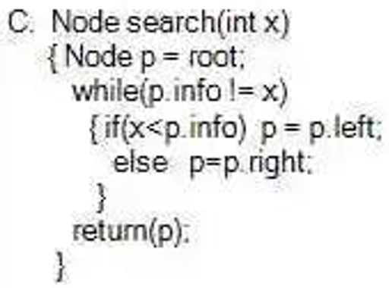
Exercise
Suppose we are considering a binary search tree.
Select the most correct java code snippet that search a node with value x.
Notes:
B

Slide 43
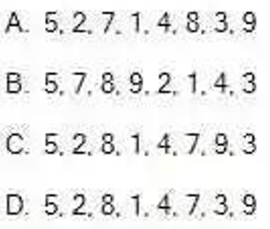
Exercise
Suppose the binary search tree T is made by inserting the following keys consequently: 5, 8, 2, 9, 7, 4, 3, 1
What is the result of breadth-first traverse of T?
Notes:
C
5
2 8
1 4 7 9
3

Slide 44
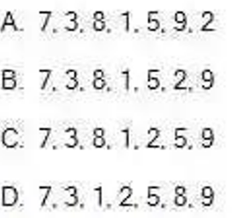
Exercise
What is the result of the breadth first traverse of the binary search tree T, after inserting nodes into the tree sequentially (suppose T is empty before insertion):
7, 8, 3, 1, 2, 5, 9
Notes:
A

Slide 45
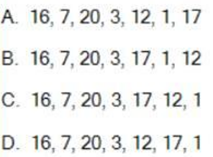
Exercise
What is the result of the breadth first traverse of the binary search tree T, after inserting the following keys
into the tree sequentially (suppose T is empty before insertion): 16, 7, 3, 1, 12, 20, 17
Notes:
D

Slide 46
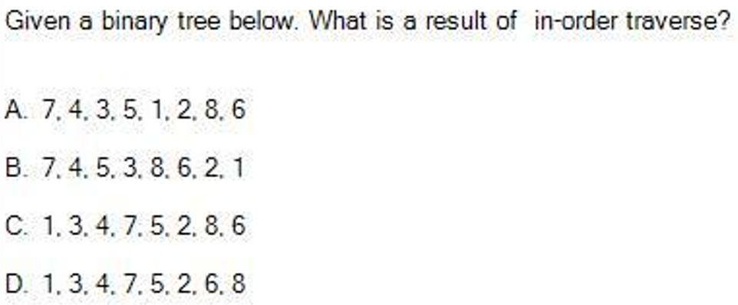
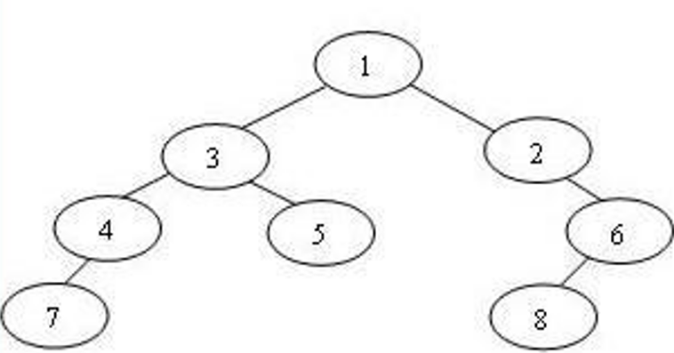
Exercise

Slide 47
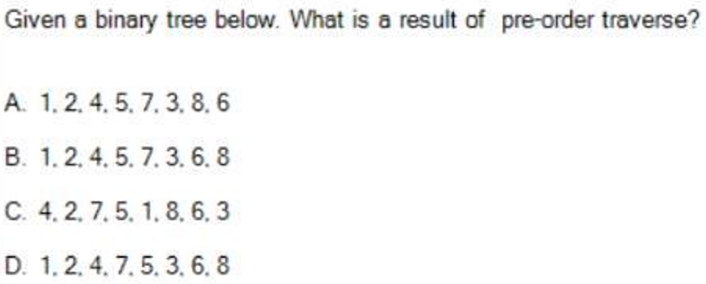
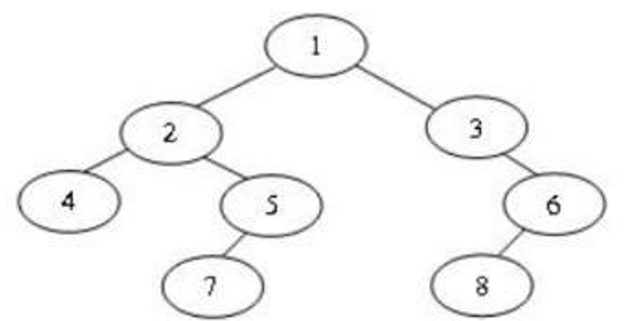
Exercise
Notes:
B

Slide 48
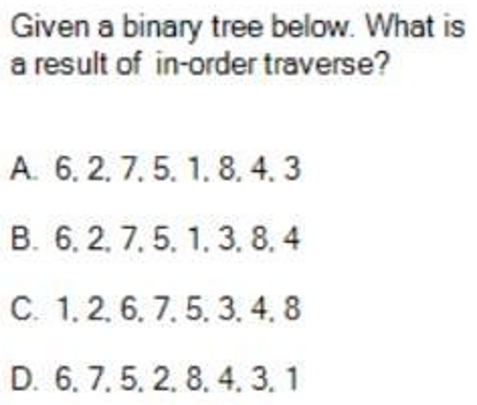
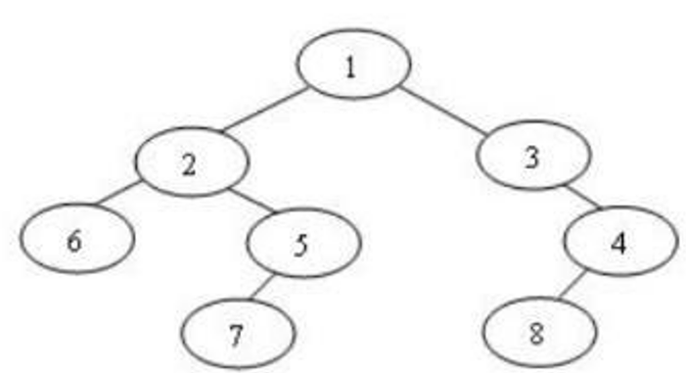
Exercise
Notes:
B

Slide 49
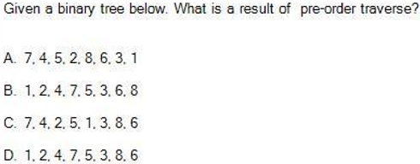
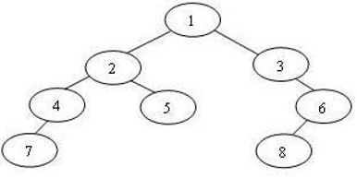
Exercise
Notes:
B

Slide 50
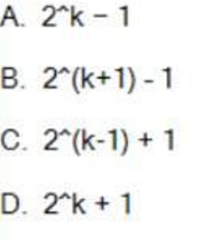
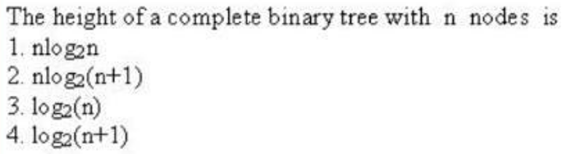
Exercise
1.
Suppose the sign ^ denotes the power operator. Maximum number of nodes in a binary tree with height k, where root is height 1, is
2.
Notes:
1. A
2. A

Slide 51
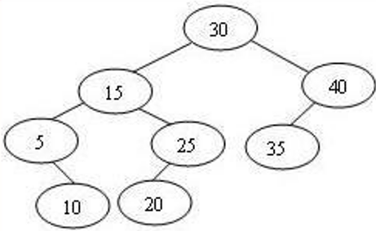
Exercise
1. In a complete binary tree with 20 nodes, and the root considered to be at level 0, how many nodes are there at level 4?
2. Suppose T is empty before insertion, what is the result of the breadth first traverse of the binary search tree T after inserting the following keys into the tree sequentially: 7, 8, 3, 1, 2, 5, 9.
3. What is the breadth-first/ depth-first traversal of a tree below after deleting the node 30 by copying?
4. What is the breadth-first/ depth-first traversal of a tree below after deleting the node 30 by merging?

Slide 52
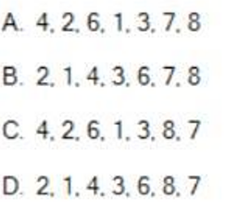
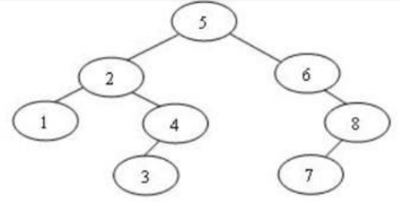
Exercise
Given a binary search tree T below. What is a result of breadth-first traverse of T after you delete by copying the root (node 5)
Notes:
C

Slide 53
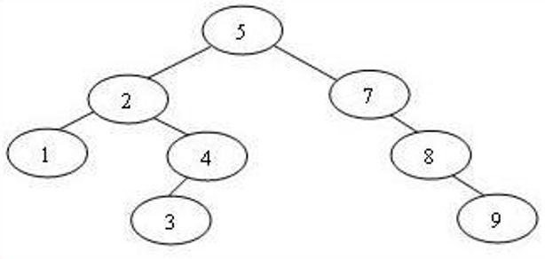
Exercise
Given a binary search tree T below. What is a result of breadth-first traverse of T after you delete by copying the root (node 5)
Notes:
C

Slide 54
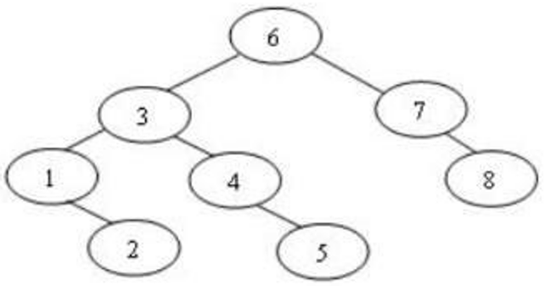
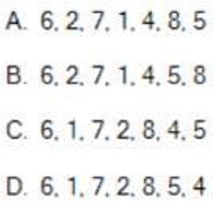
Exercise
Given a binary search tree T below. What is a result of breadth-first traverse of T after you delete by merging the node 3?
Notes:
C

Slide 55
Exercise
Binary search algorithm cannot be applied to:
A. sorted linear array
B. sorted doubly linked list
C. Binary search tree
2. Consider the AVL tree below. What is the breadth first traversal of the tree after inserting a node with value 22
A. 35, 20, 45, 10, 25, 40, 30, 22
B. 35, 20, 45, 10, 40, 25, 22, 30
C. 35, 20, 45, 10, 25, 40, 22, 30
D. 35, 20, 45, 10, 30, 40, 25, 22
Notes:
1. B
2. C

Slide 56
Exercise
Suppose we are considering a binary search tree. Select the most correct java code snippet that search a node with value x.
A. Node search(int x)
{ Node p = root;
while(p.info != x)
{ if(x<p.info) p = p.left:
else p=p.right;
}
retum(p);
}
B. Node search(int x)
{ Node p = root;
while(p.info != x && p != null)
{ if(x<p.info) p =p.left:
else p=p.right;
}
retum(p);
}
C. Node search(int x)
{ Node p = root:
while(p != null && p.info != x)
{ if(x<p.info) p = p.left:
else p=p.right;
}
retum(p);
}
Notes:
C

Slide 57
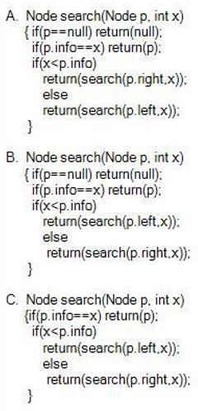
Exercise
Suppose we are considering a binary search tree.
Select the most correct java code snippet that search a node with value x on the sub-tree with root p.
Notes:
B

Slide 58

Exercise
Consider the binary tree below. Which statement is correct? (full binary tree = proper binary tree = 2-tree)
A. The tree is full but not complete.
B. The tree is neither complete nor full.
C. The tree is both full and complete.
D. The tree is complete but not full.
Notes:
D

Slide 59
Summary
59
What is a Trees?
Tree Terminology
Tree examples
Ordered Trees
Tree Traversals
Binary Trees
Implementing Binary Trees
Binary Search Tree
Insertion
Deletion
Notes:
59

Slide 60
Reading at home
Text book: Data Structures and Algorithms in Java
8 Trees 307
8.1 General Trees - 308
8.1.1 Tree Definitions and Properties - 309
8.1.2 The Tree Abstract Data Type - 312
8.2 Binary Trees - 317
8.2.1 The Binary Tree Abstract Data Type - 319
8.2.2 Properties of Binary Trees - 321
8.3 Implementing Trees - 323
8.4 Tree Traversal Algorithms - 334
11.1 Binary Search Trees - 460
11.1.1 Searching Within a Binary Search Tree - 461
11.1.2 Insertions and Deletions - 463

